Slide 1
CIS 5525: Neural Computation
Week IV: Convolutional Neural Networks
Instructor: Kai Zhang
CIS @ Temple University, Spring 2020

Slide 2
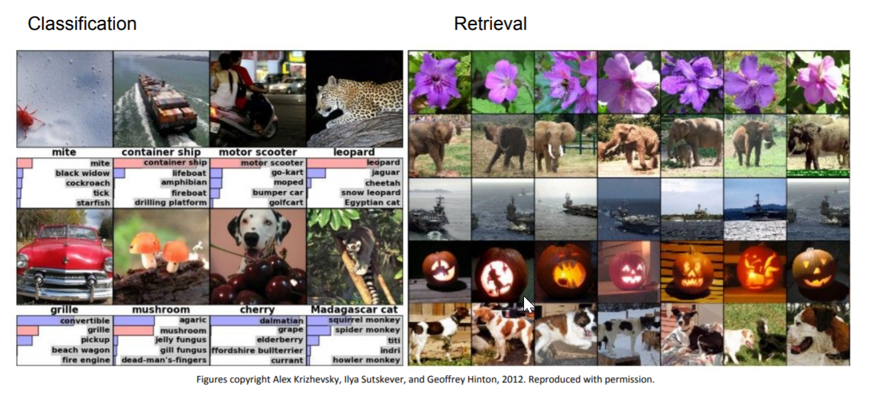
CNN’s are everywhere
Image related

Slide 3
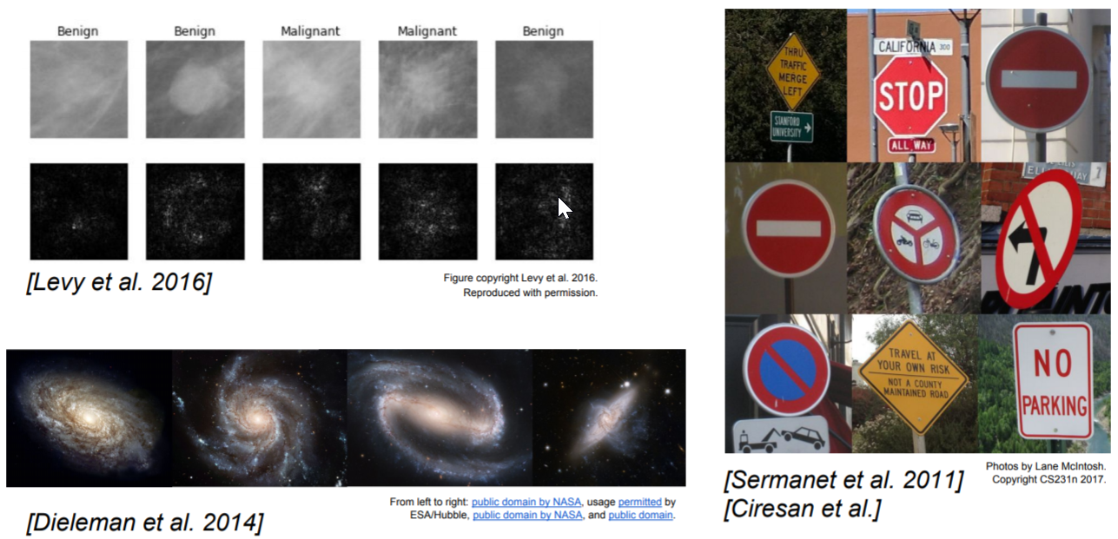
CNN’s are everywhere

Slide 4
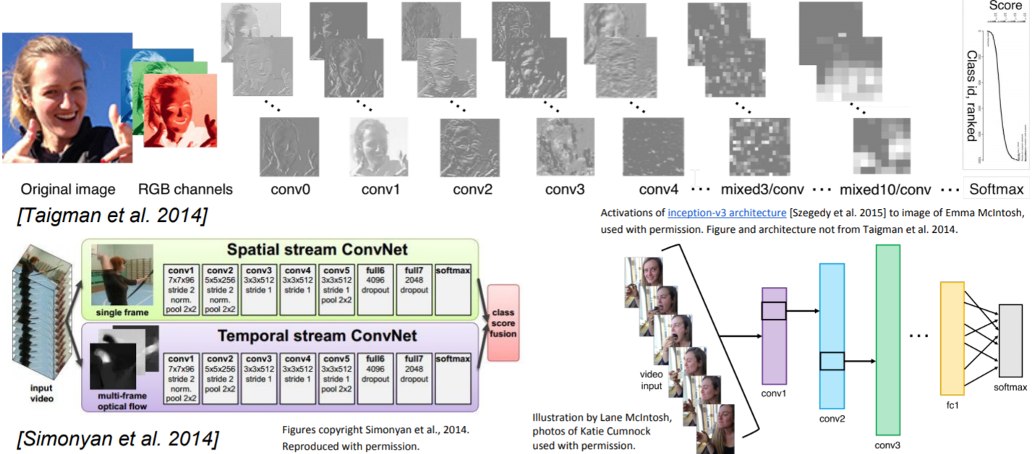
CNN’s are everywhere

Slide 5
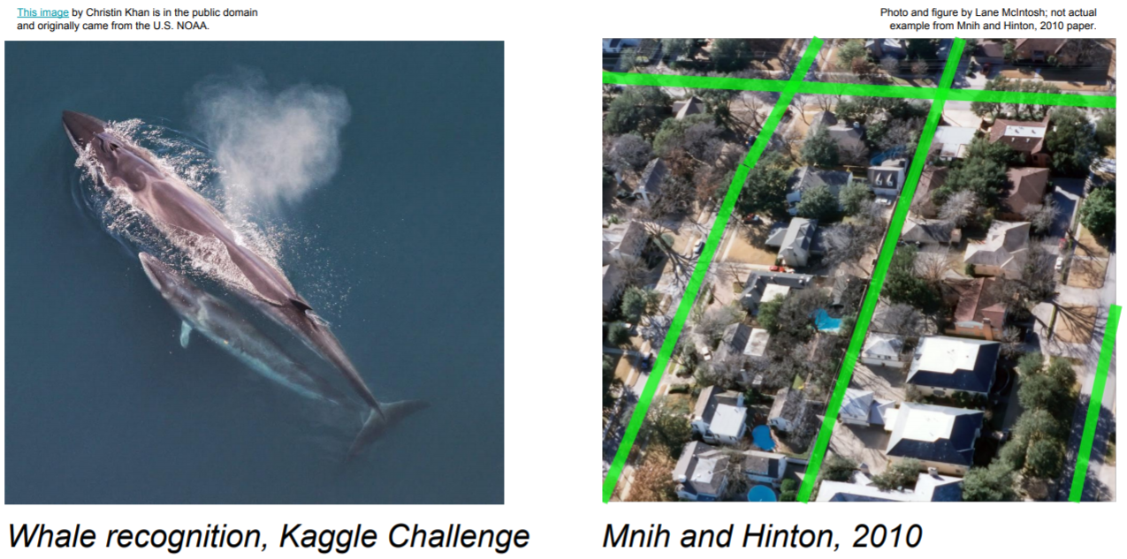
CNN’s are everywhere

Slide 6
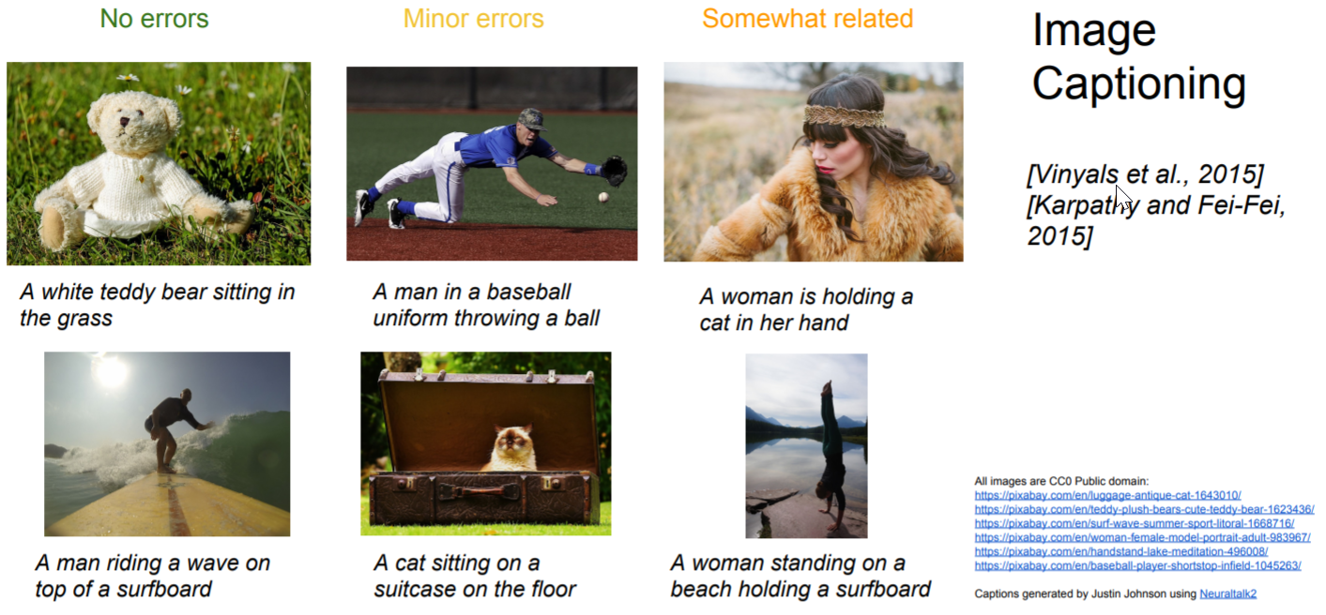
CNN’s are everywhere

Slide 7
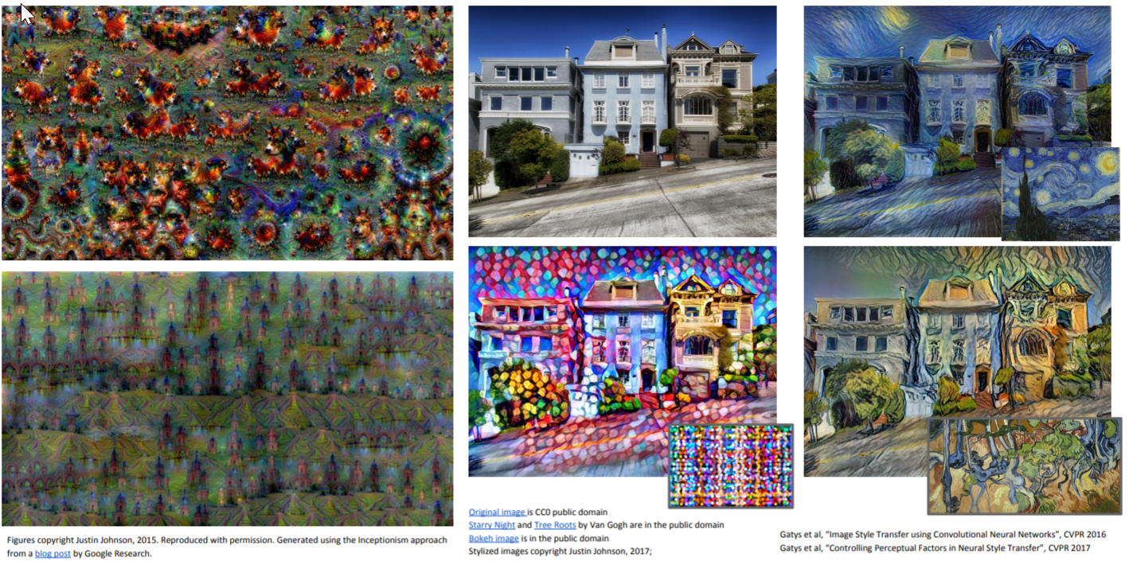
CNN’s are everywhere

Slide 8
CNN’s are everywhere
Becoming more popular in NLP
Semantic parsing (Yih et al., “Semantic Parsing for Single-Relation Question Answering”, ACL 2014)
Search query retrieval (Shen et al., “Learning Semantic Representations Using Convolutional Neural Networks for Web Search”, WWW 2014)
Sentiment analysis (Kalchbrenner et al., “A Convolutional Neural Network for Modelling Sentences”, ACL 2014; dos Santos and Gatti
“Deep Convolutional Neural Networks for Sentiment Analysis of Short Texts”, COLING 2014)

Slide 9
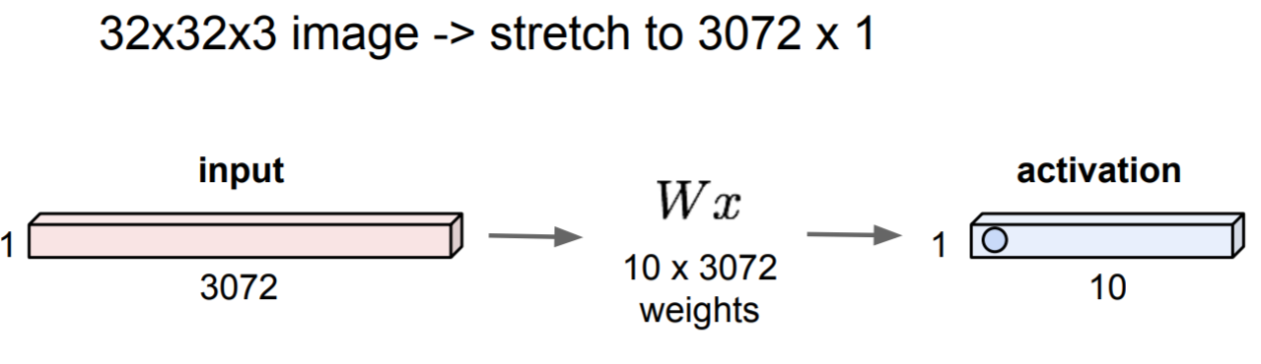
Not-clever Idea

Slide 10

2-d signal convolution
kernel
Illustration of a 2-d convolution
1
0
1
0
1
0
1
0
1
Signal dimension changes after convolution
Kernel parameter sharing across signal location
Parallelization friendly

Slide 11
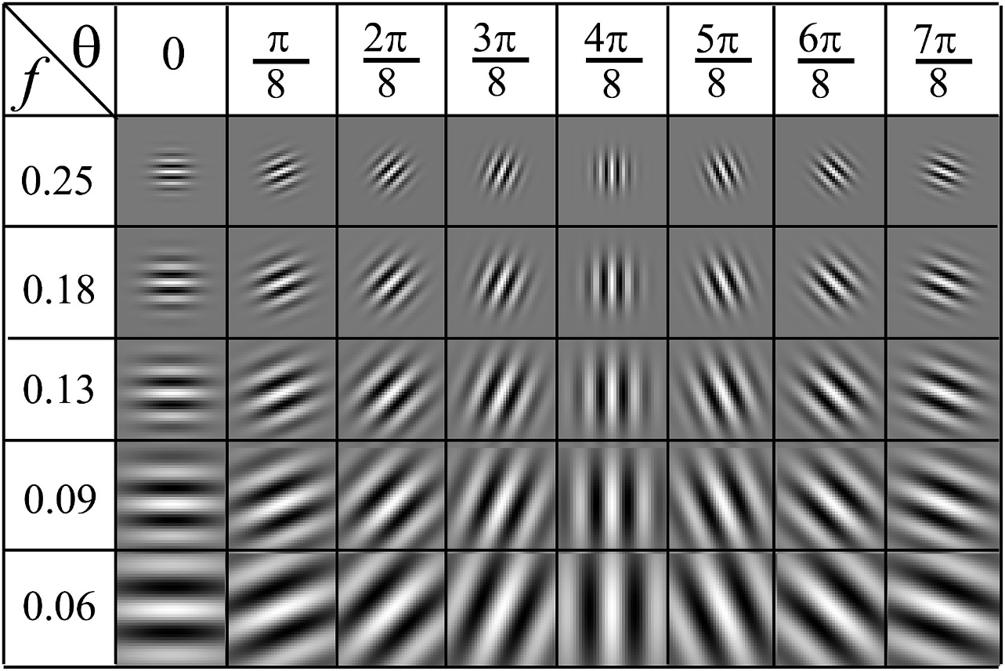
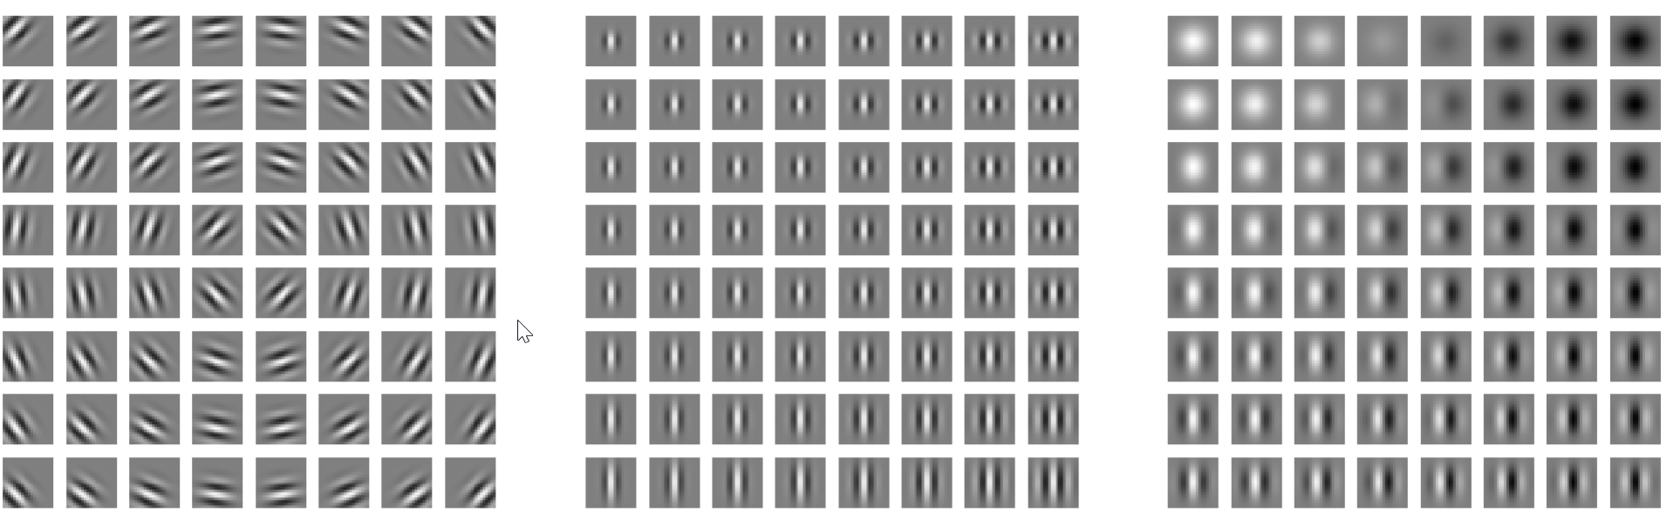
Gabor Filters
Gabor Filter Bank
Product of a Gaussian with sine or cosine
Often used in detecting textures of varying directions and frequencies

Slide 12
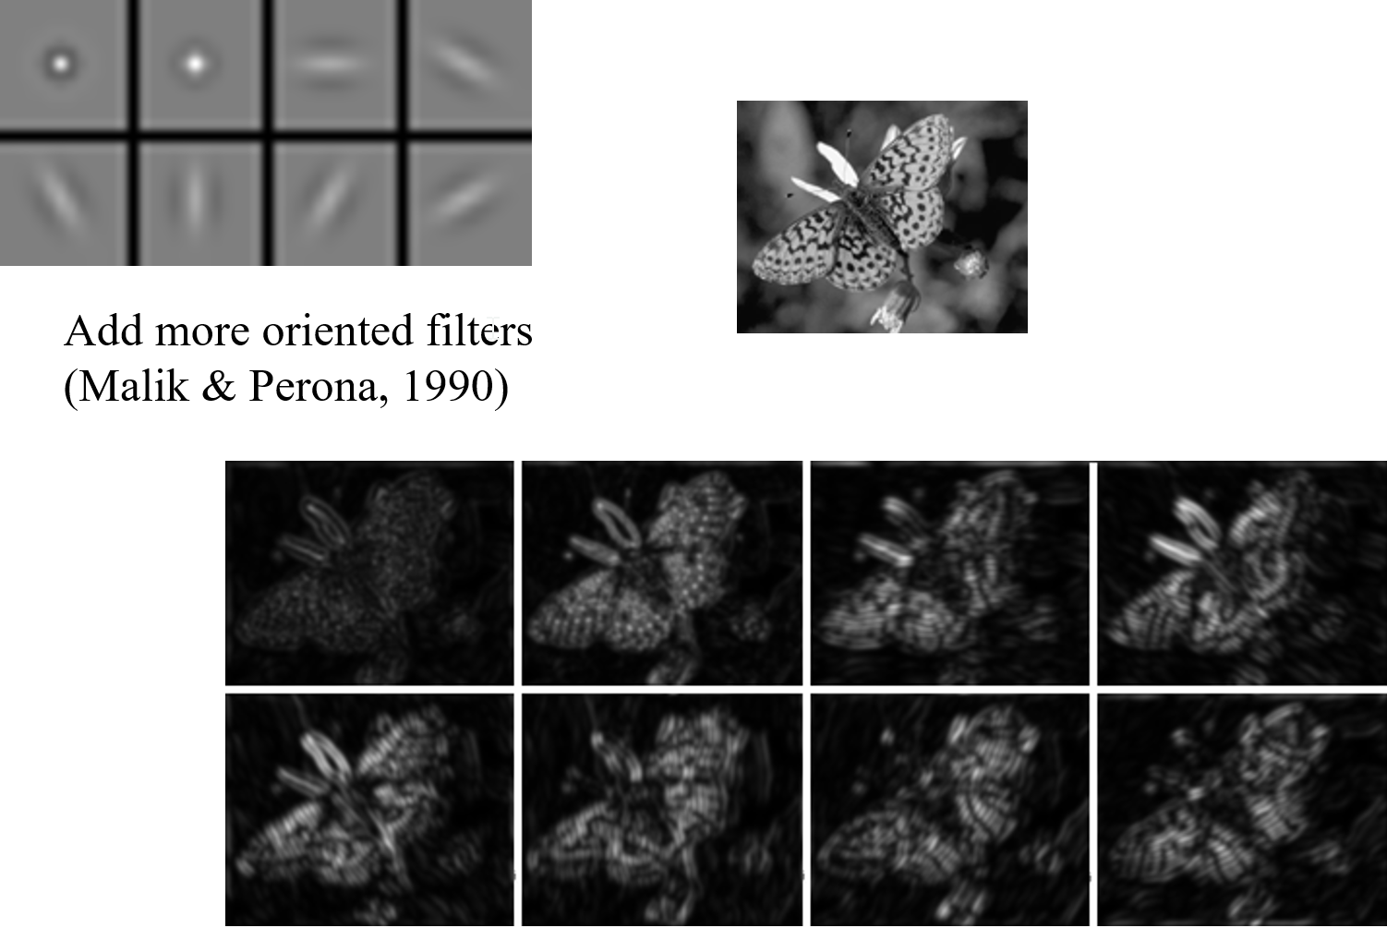

Slide 13
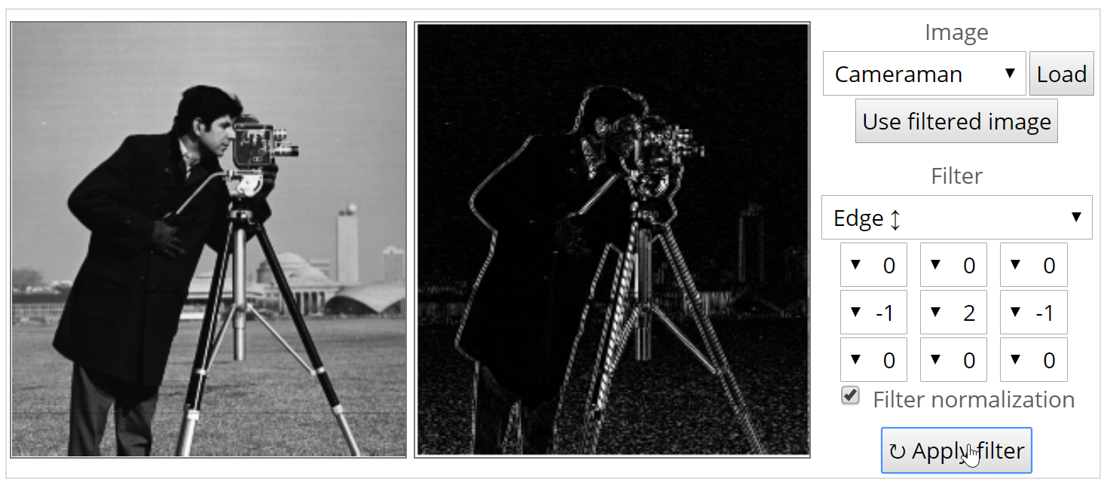
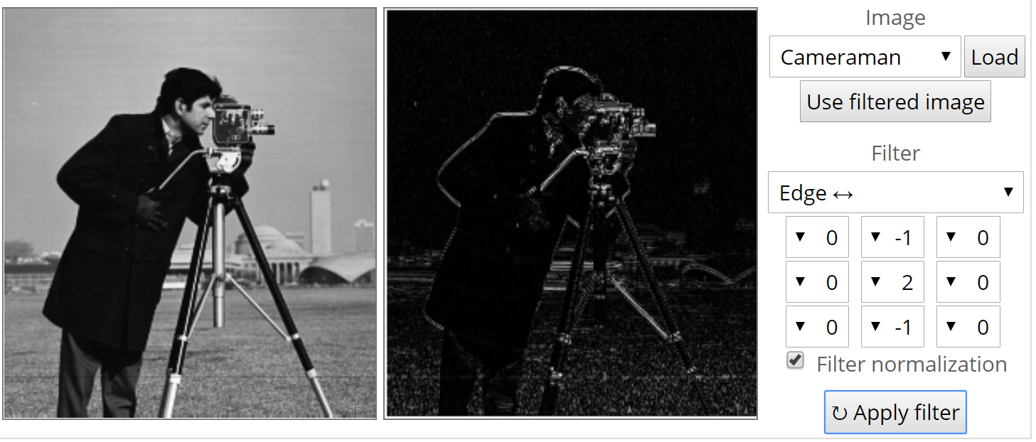
Image Filtering

Slide 14
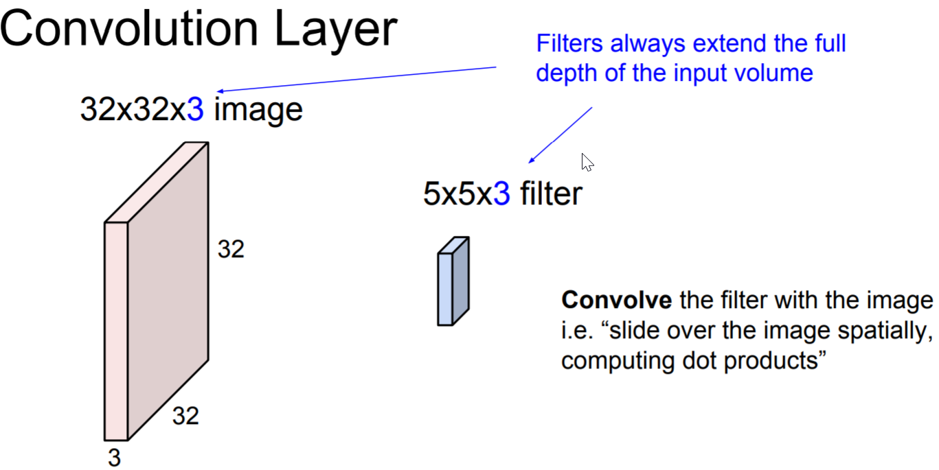
Convolutional Layer

Slide 15
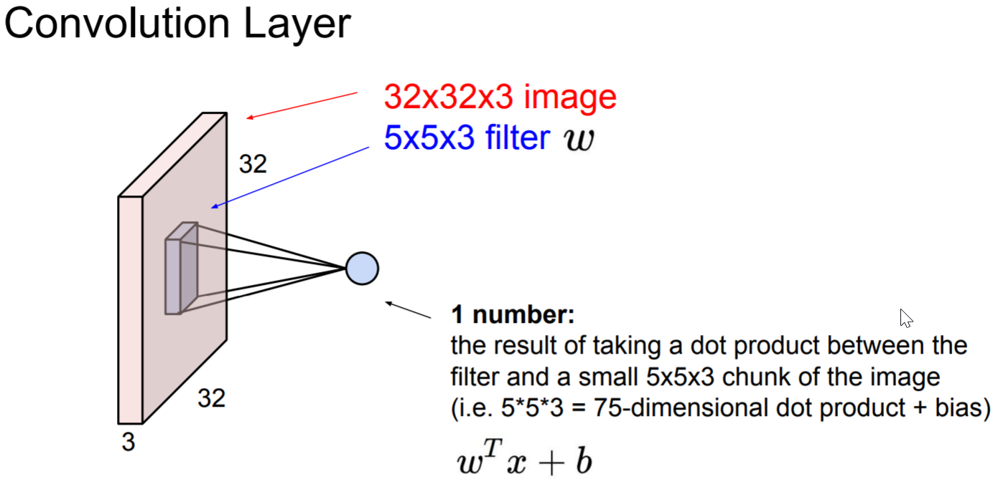

Slide 16
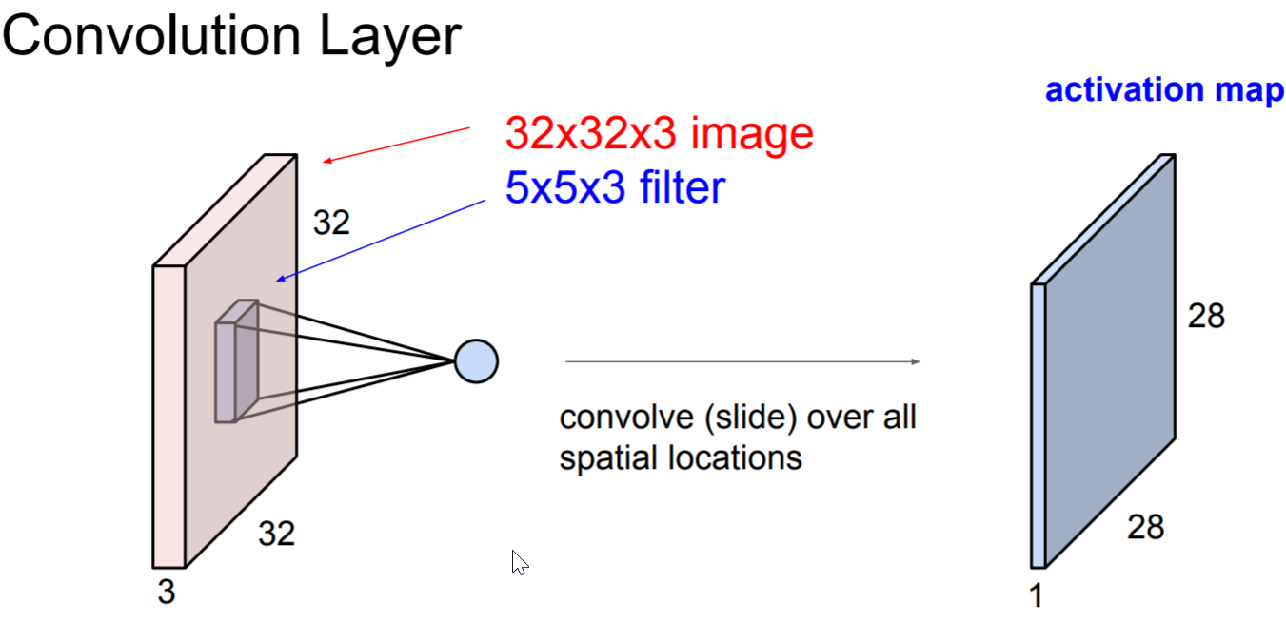

Slide 17
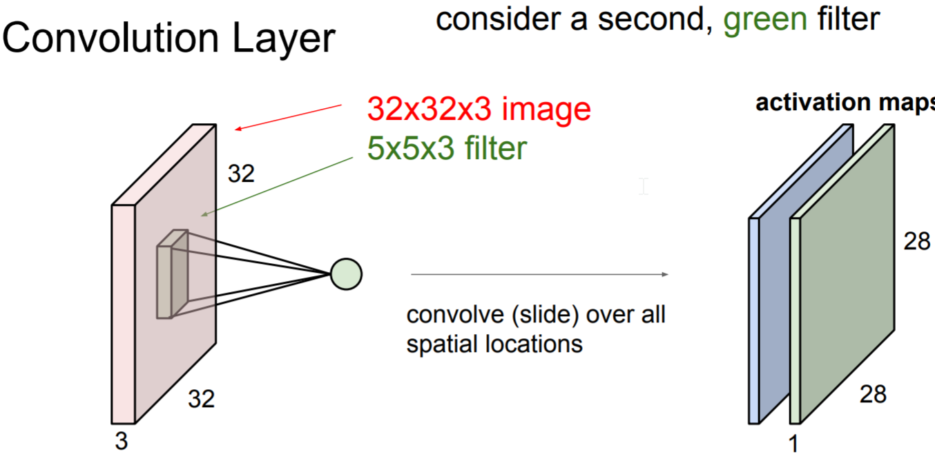

Slide 18
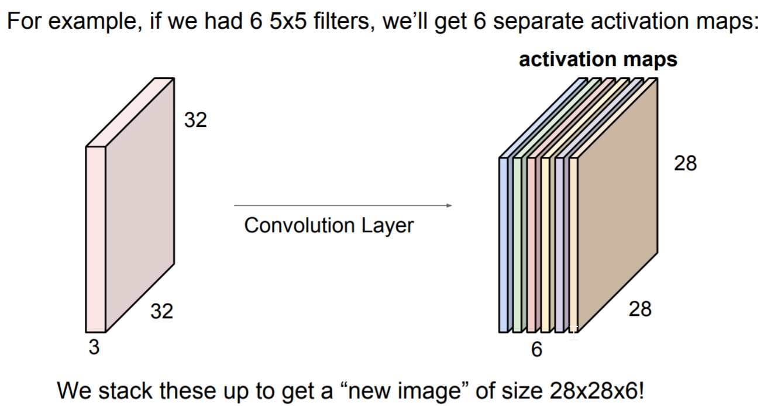

Slide 19
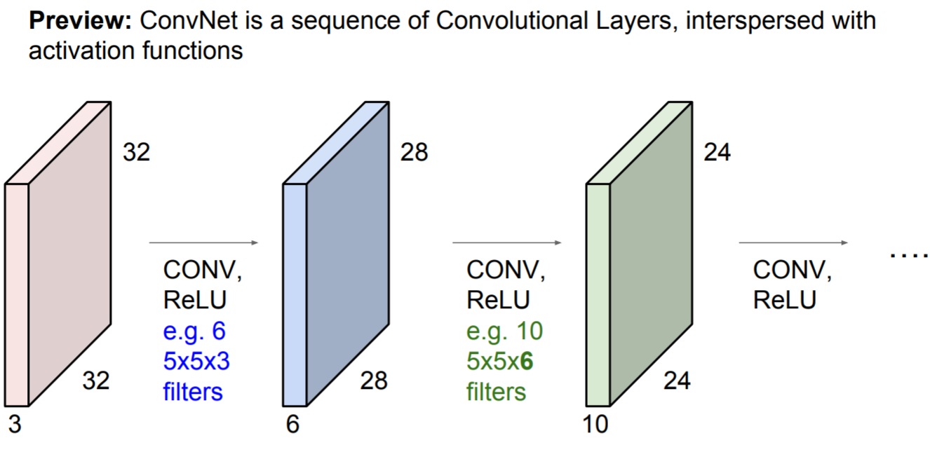

Slide 20
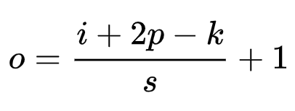
Dimensions in CNN
Relation between the dimensions in 2d CNN
Input image size: i-by-I
Output image size: o – by – o
Kernel size: k – by – k
Strides: s
Padding: p
They satisfy the equality
Check the illustration https://github.com/vdumoulin/conv_arithmetic

Slide 21
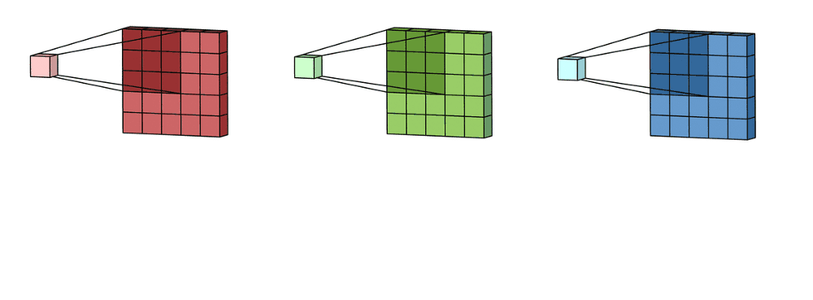
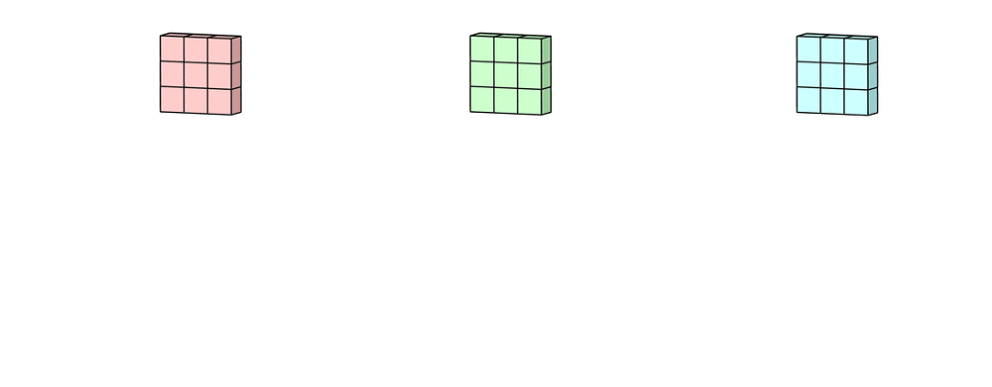
Convolution on Tensors (2D convolution)
input layer is a 5 x 5 x 3 matrix, with 3 channels. filter is a 3 x 3 x 3 matrix.

Slide 22
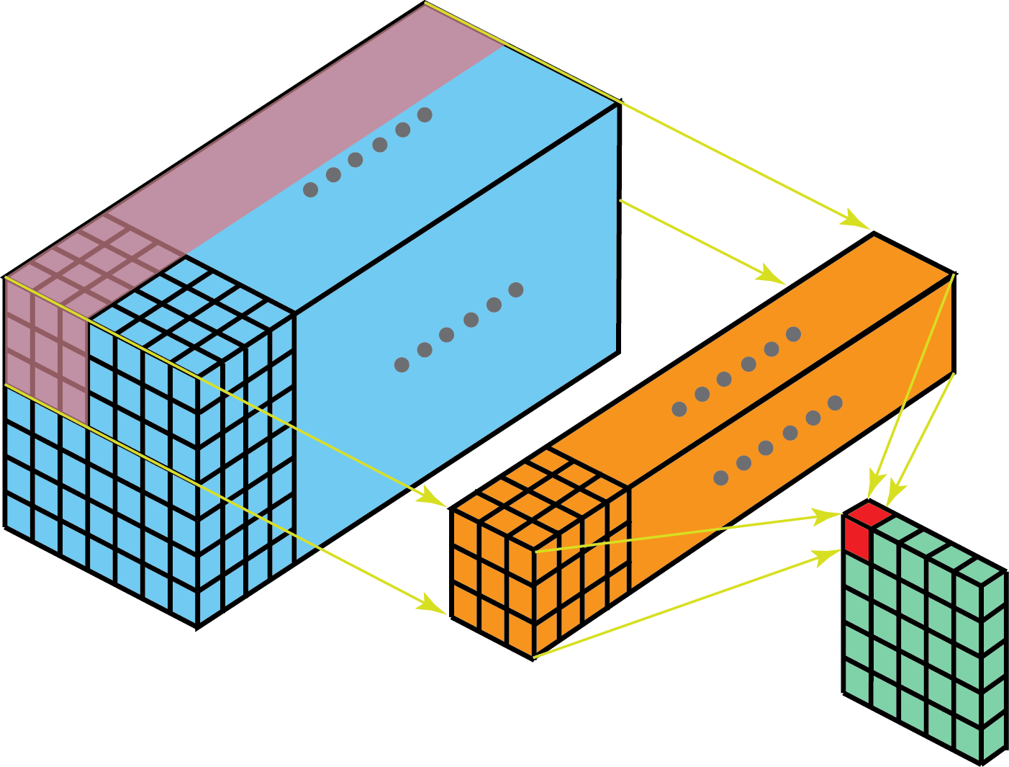
Equivalently, we can think of this process as sliding a 3D filter matrix through the input layer.

Slide 23
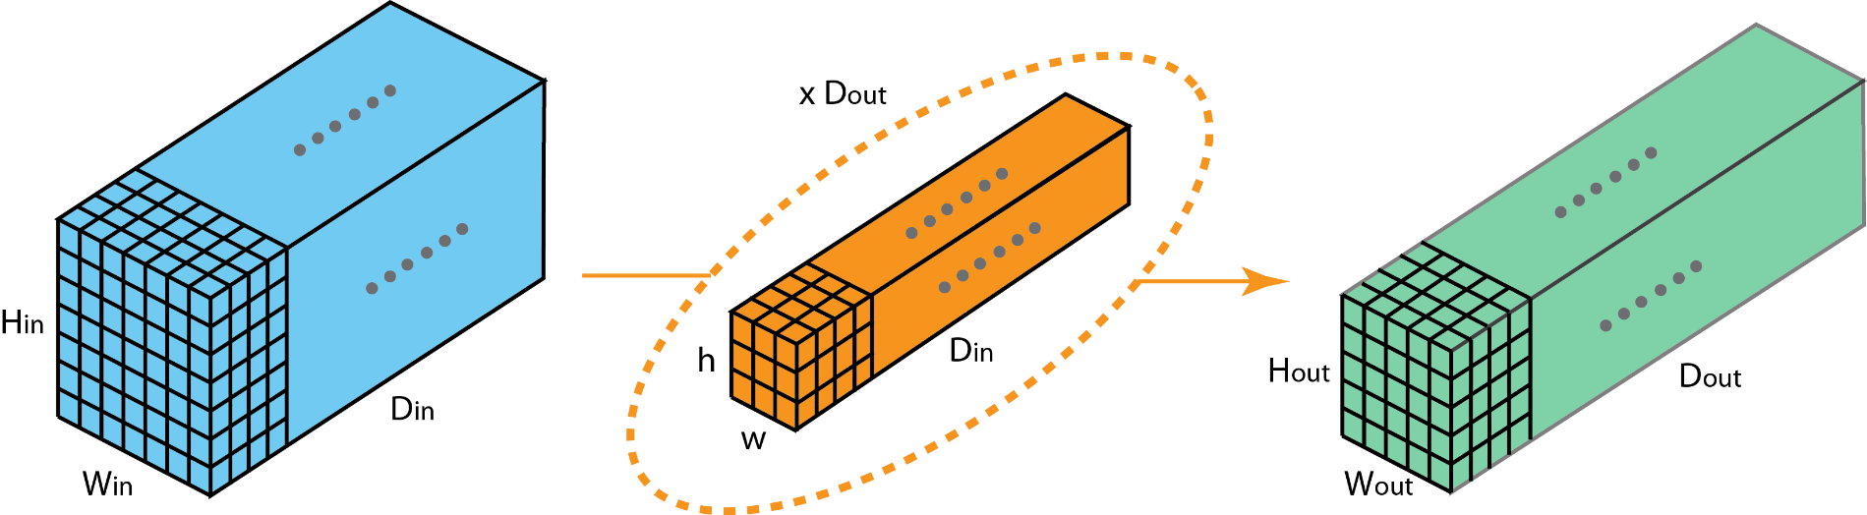
transitions between layers with different depth.
Let’s say the input layer has Din channels, and we want the output layer has Dout channels.
apply Dout filters to the input layer. Each filter has Din kernels.
Each filter provides one output channel.
After applying Dout filters, we have Dout channels, which can then be stacked together to form the output layer.

Slide 24
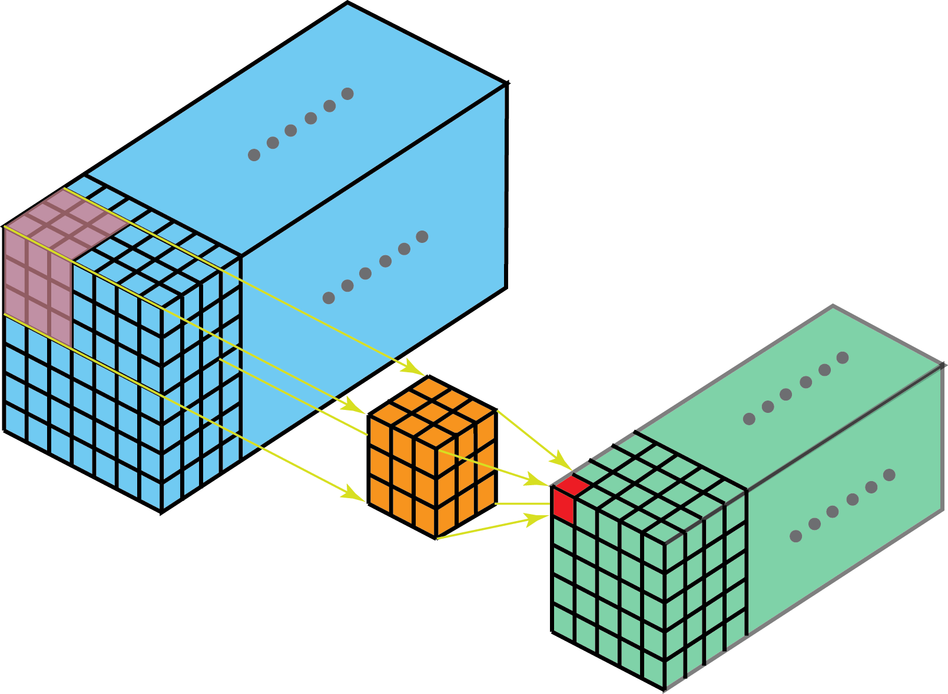
3D convolutions
In 3D convolution, the filter depth is smaller than the input layer depth (kernel size < channel size).
As a result, the 3D filter can move in all 3-direction (height, width, channel of the image). At each position, the element-wise multiplication and addition provide one number.
Since the filter slides through a 3D space, the output numbers are arranged in a 3D space as well. The output is then a 3D data.

Slide 25
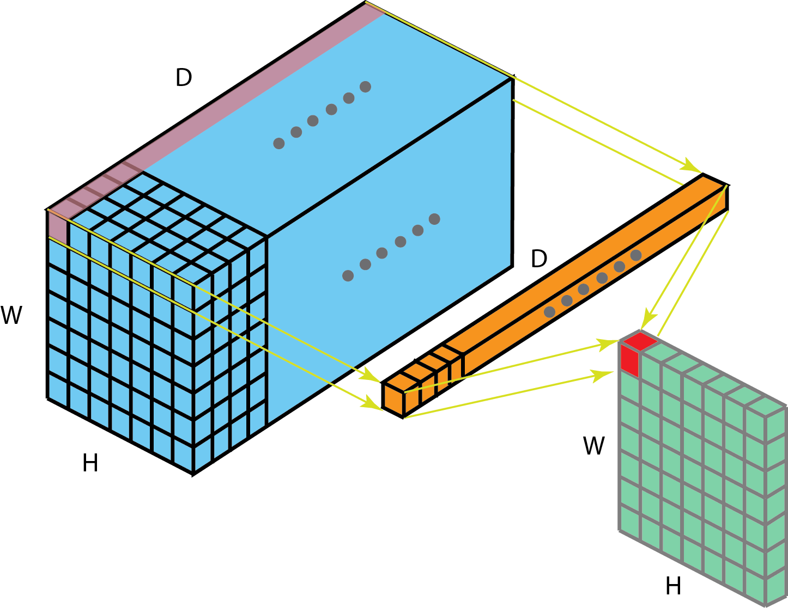
1D Convolutions
Input layer with dimension H x W x D.
After 1 x 1 convolution with filter size 1 x 1 x D, the output channel is with dimension H x W x 1.
If we apply N such 1 x 1 convolutions and then concatenate results together, we could have a output layer with dimension H x W x N.

Slide 26
1D Convolutions
Advantages of 1-by-1 convolution
Dimensionality reduction for efficient computations
Efficient low dimensional embedding, or feature pooling
Applying nonlinearity again after convolution

Slide 27

Other operations in CNN
Nonlinear transform
Same as in feedforward neural networks
Pooling layer (down sampling)
Aggregate pixels information spatially: compute mean/max/min of a region in the feature map
These summary statistics lead to lower dimension
Reduce model size, overfitting, improve scaling invariance
Stride parameter
“sampling rate”
Controls the interval of region operation.

Slide 28
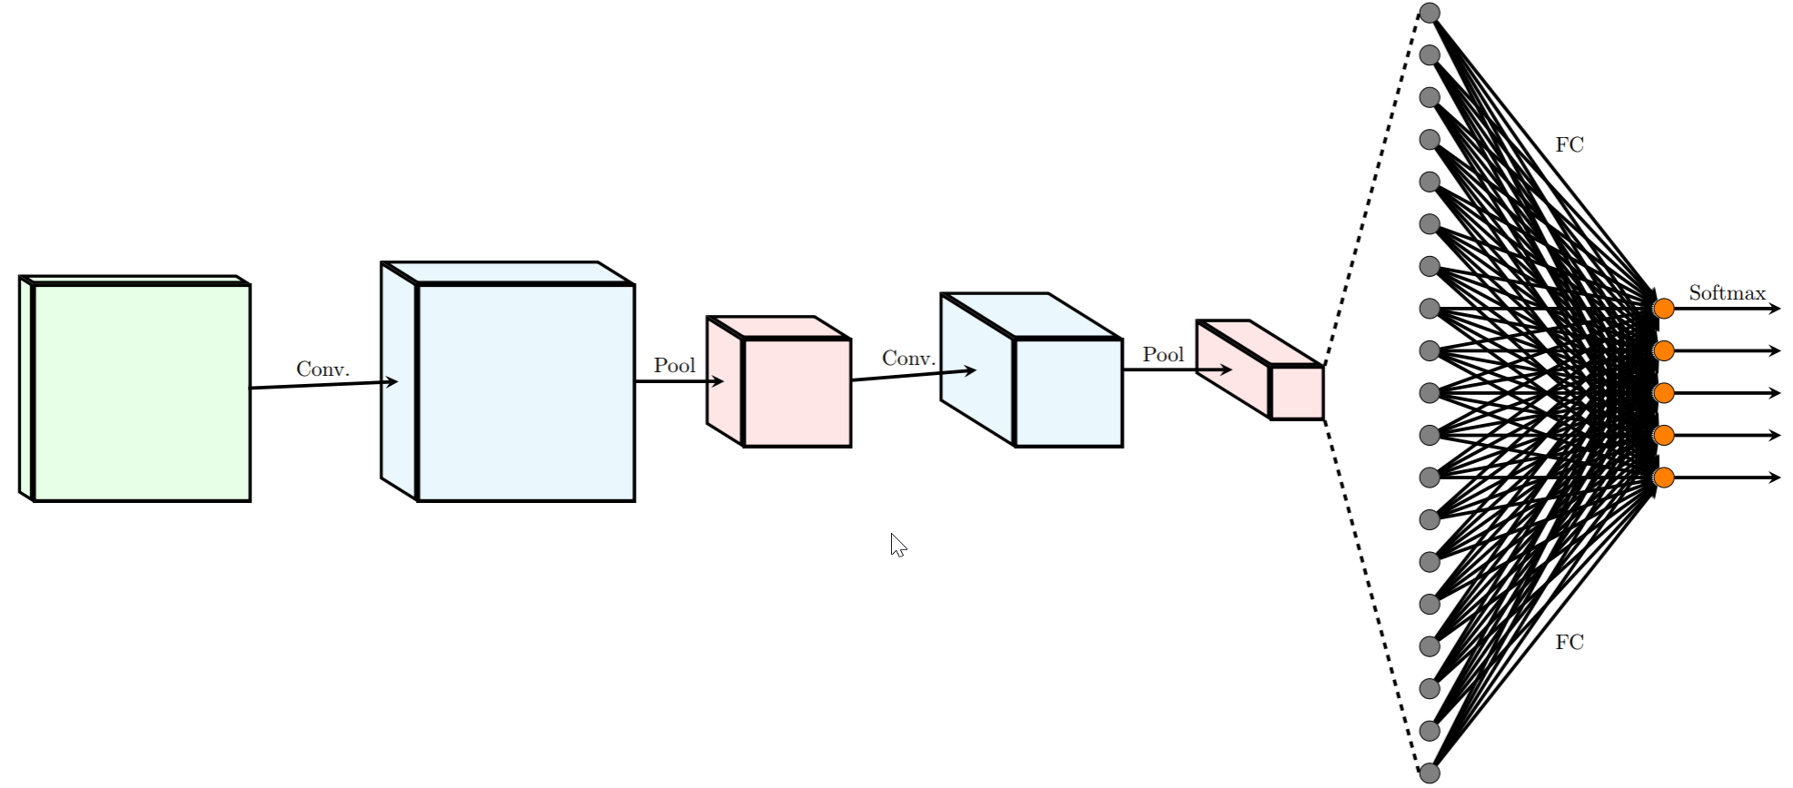
Stack all layers together

Slide 29
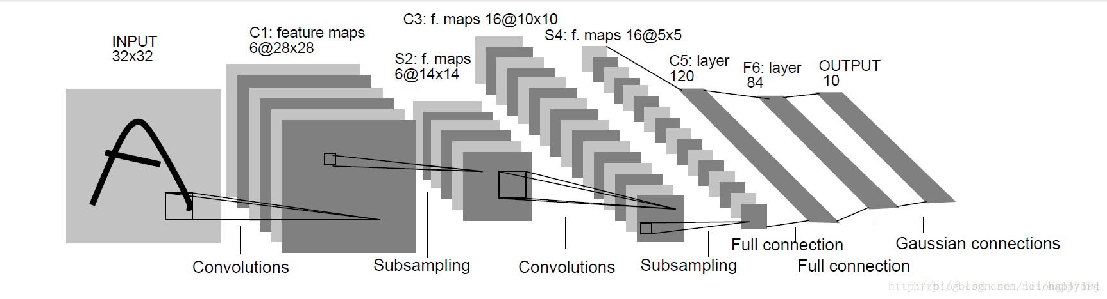
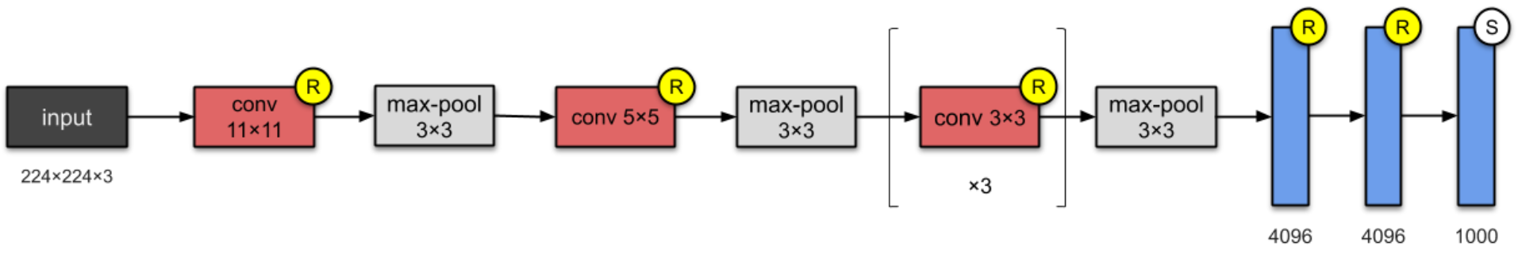
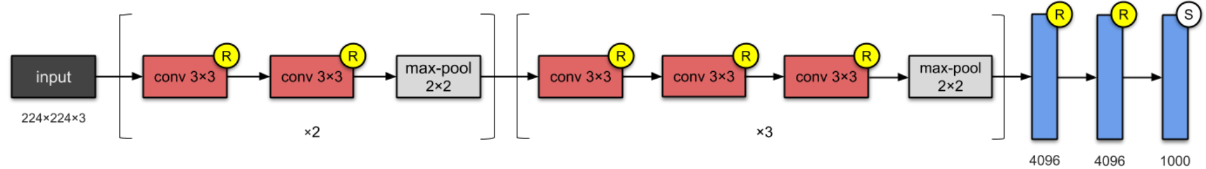
Some classic CNN’s
Lenet
Alex net (2012)
VGG-16 (2014)

Slide 30
CNN Internal Representations
Observe the learnt kernels;
Pass an input through the network, observe the activations (feature map);
Pick those samples with highest activations

Slide 31
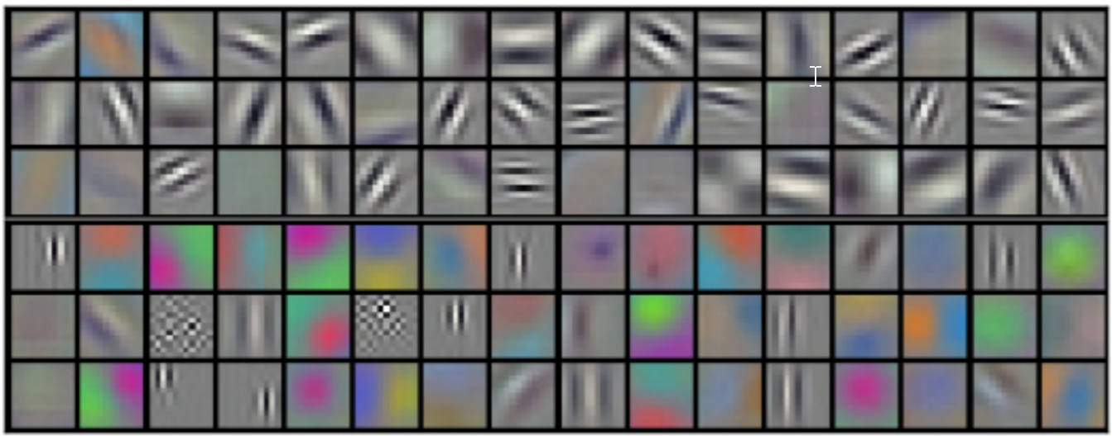
Examination of kernels
The first layer of kernels reveals. . . In almost all cases, these kernels will learn to become edge detectors and low-level visual patterns

Slide 32
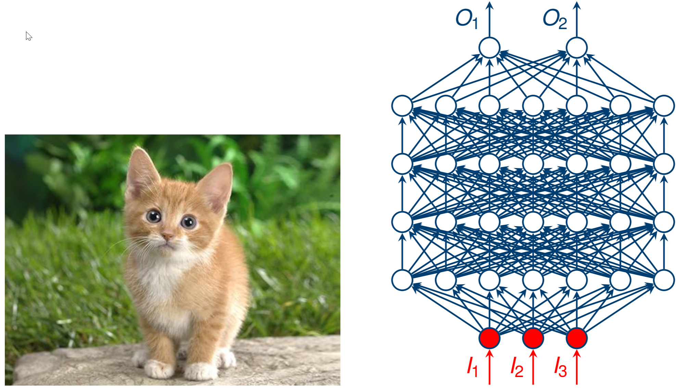
Passing the data through the network

Slide 33
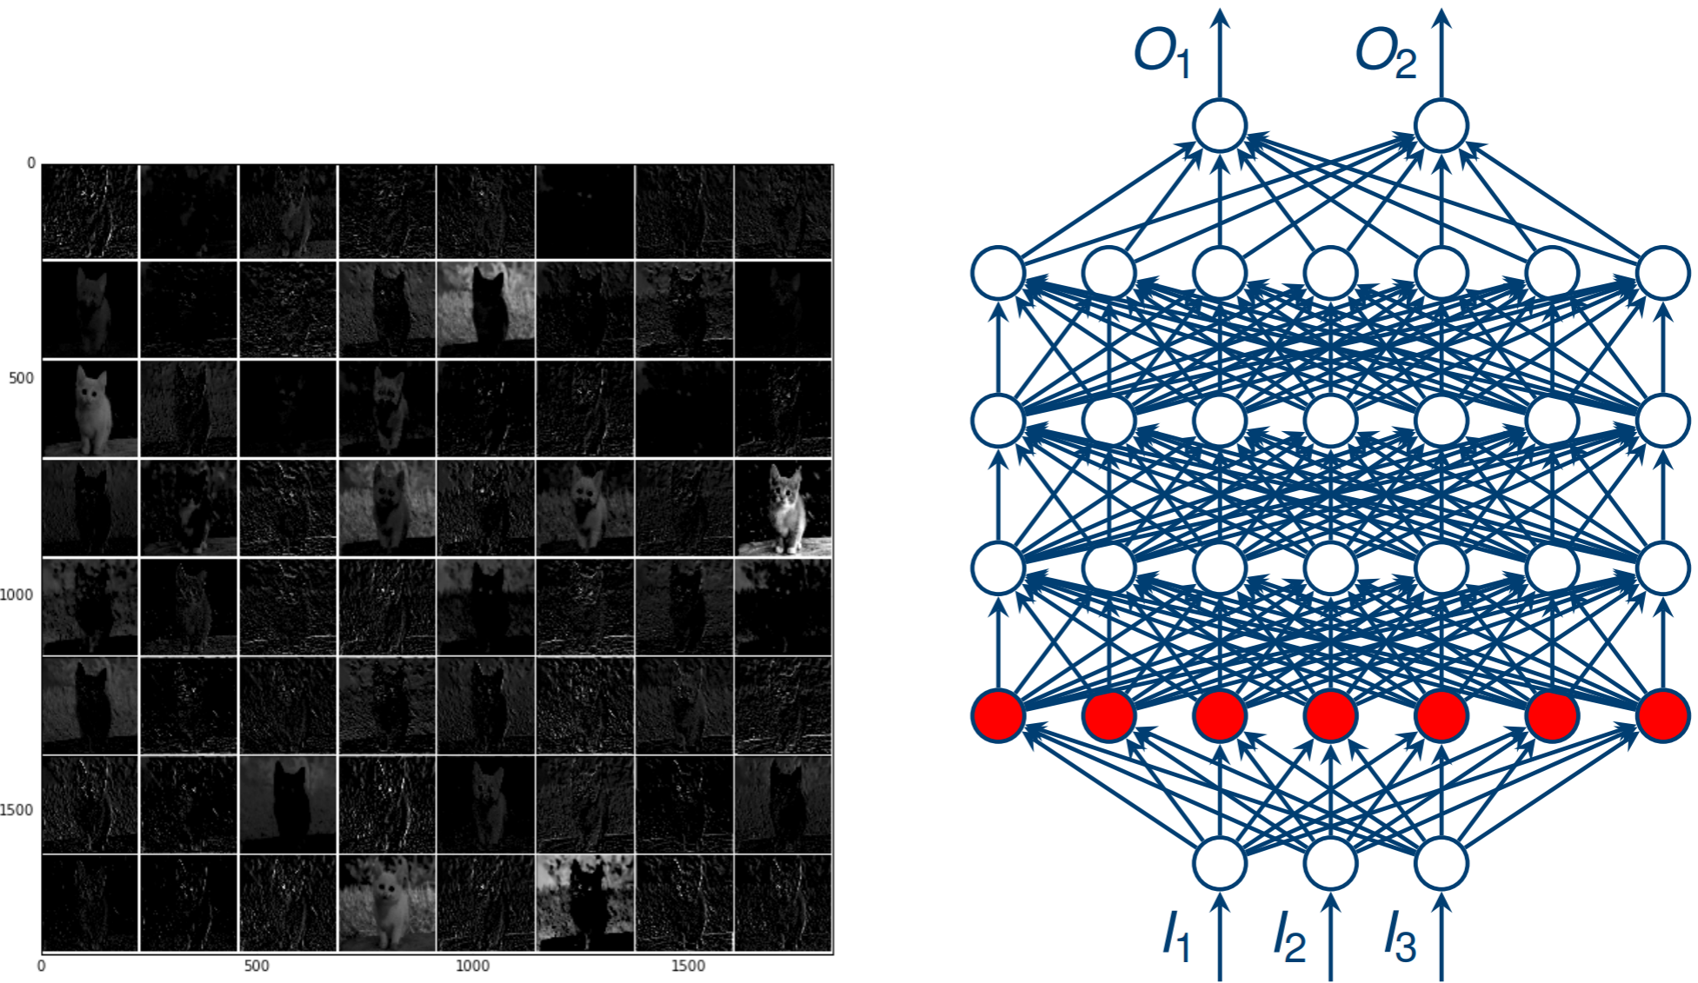

Slide 34
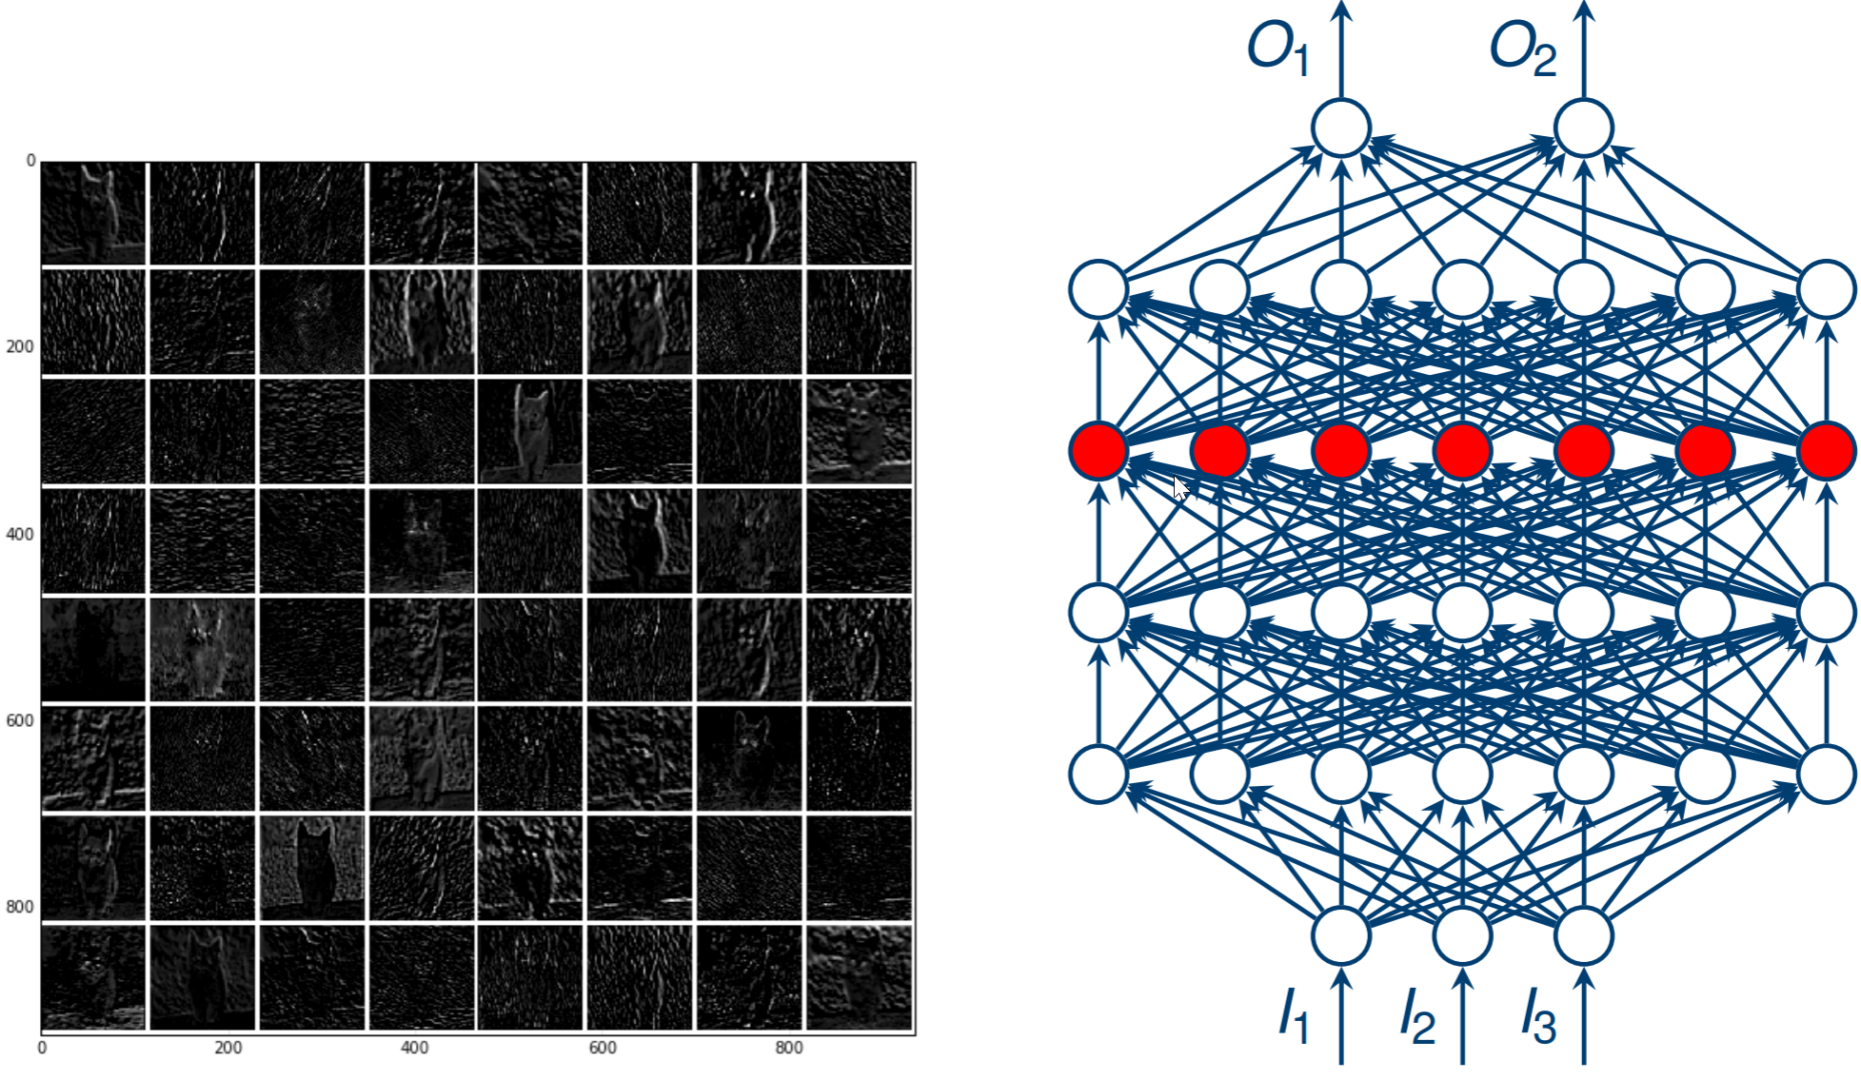

Slide 35
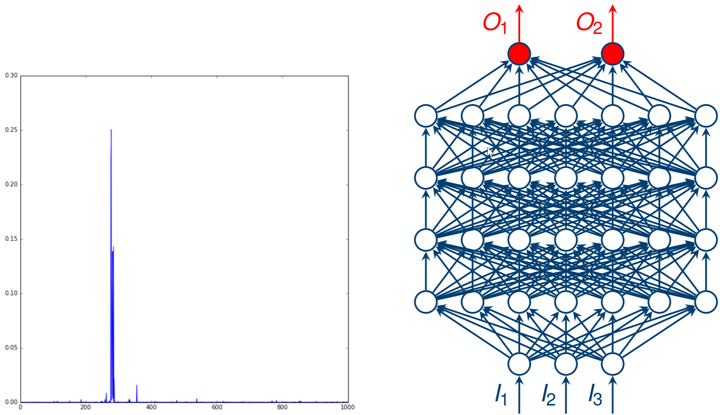

Slide 36
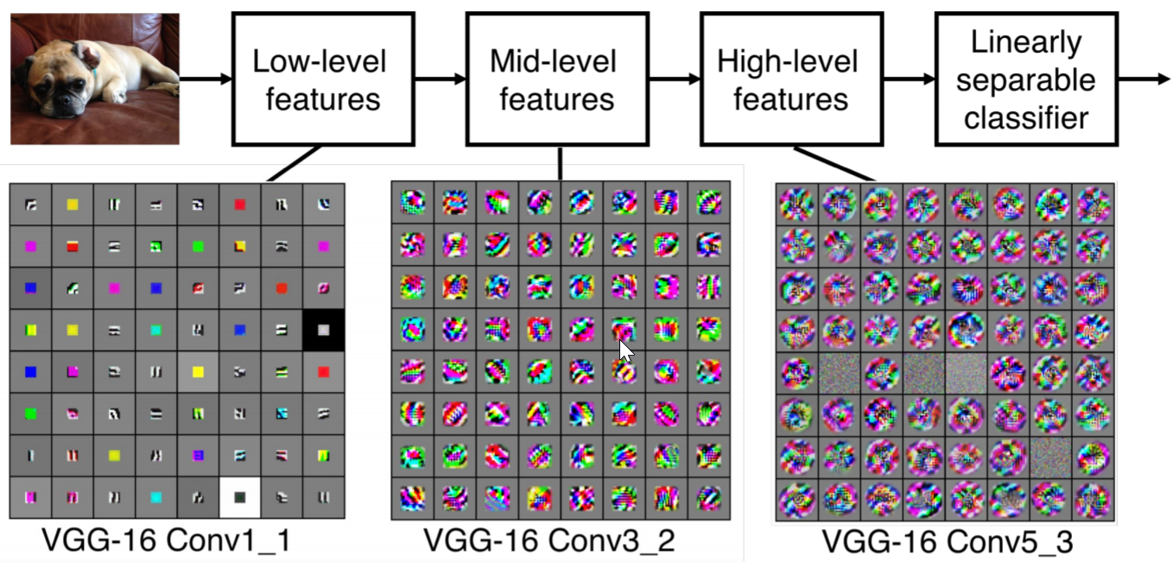

Slide 37
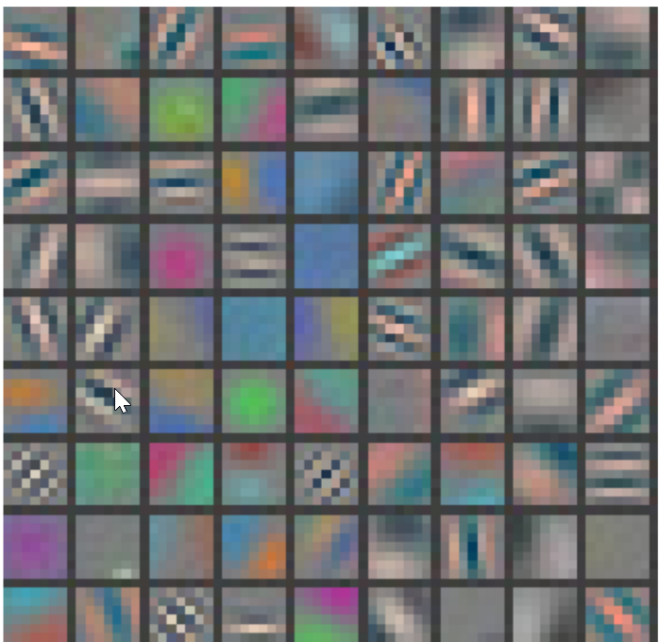
Hierarchical structures of CNN
Showing 81 filters of 11x11x3.
Capture low-level features like oriented edges, blobs.
First layer of CNN almost always edge filters

Slide 38
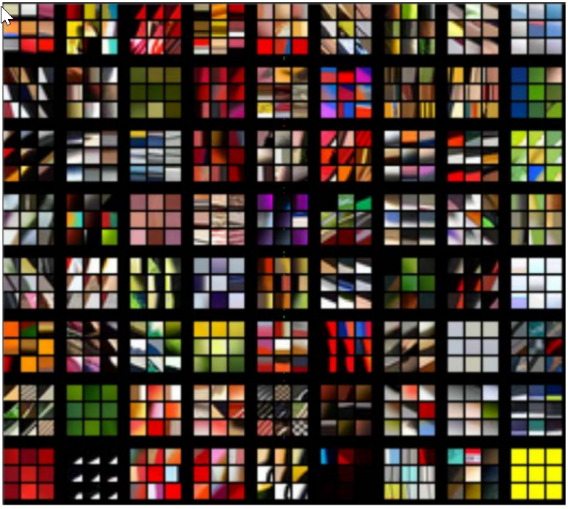
Top 9 patches that activate each filter in layer 1

Slide 39
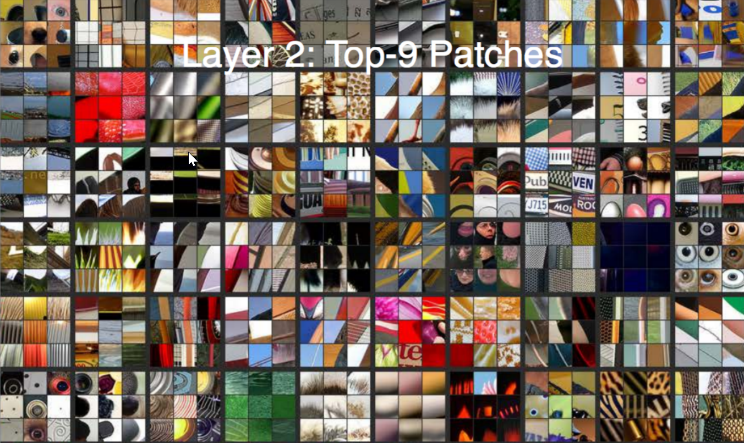
Note how the previous low-level features are combined to detect a little more abstract features like textures.

Slide 40
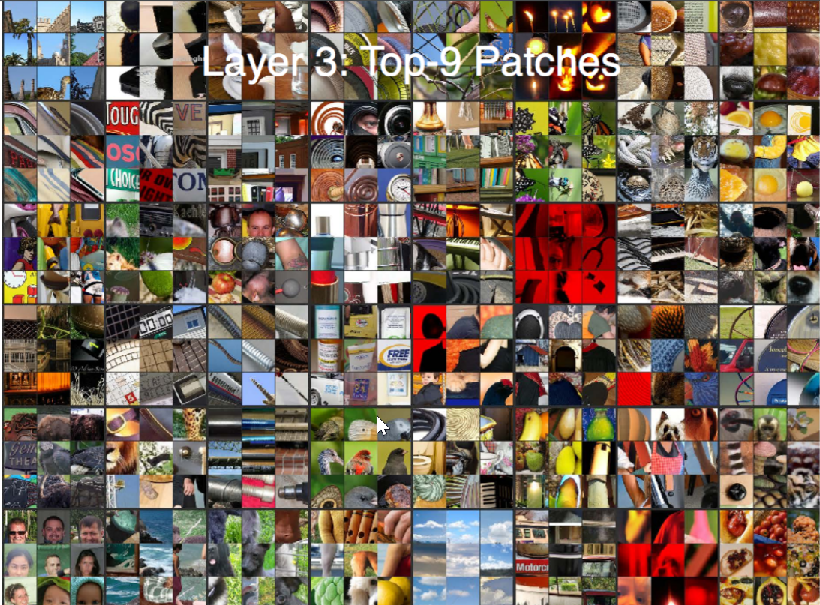

Slide 41
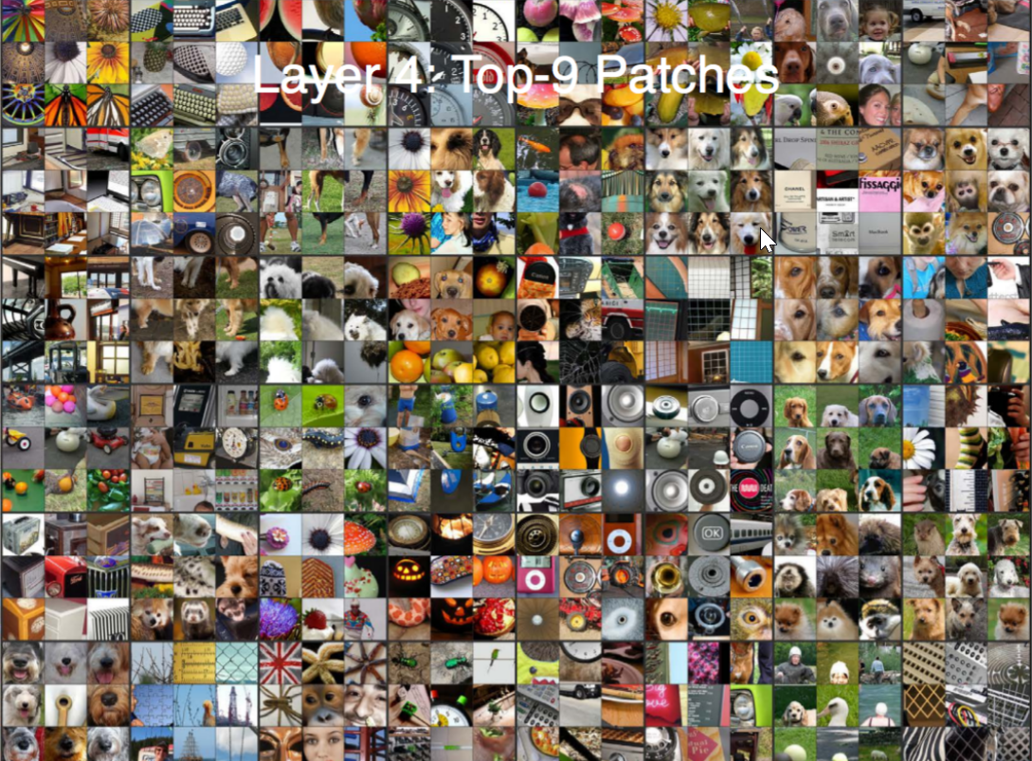

Slide 42
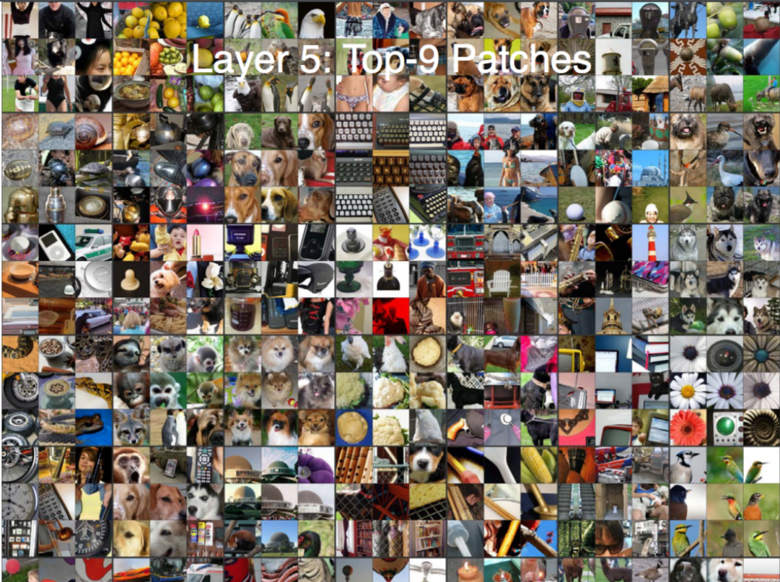

Slide 43
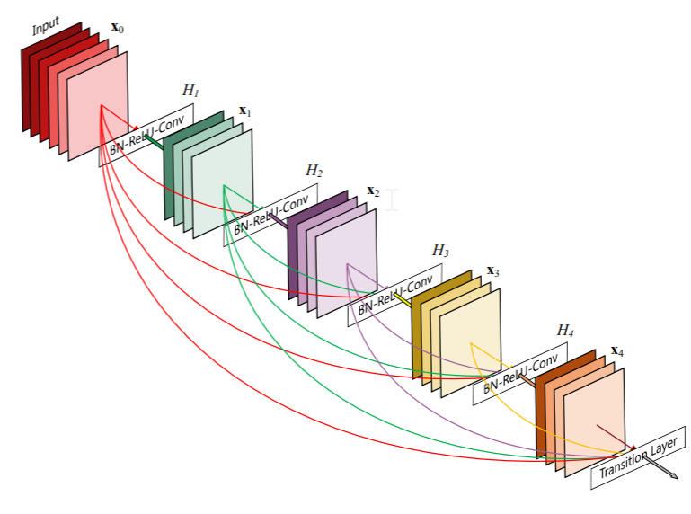
Dense-net
Huang et al., Convolutional Networks with Dense Connectivity

Slide 44
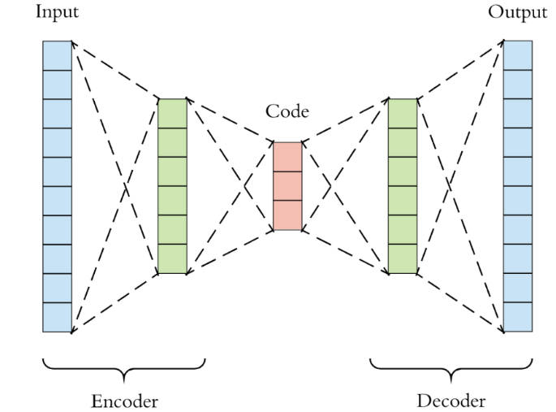
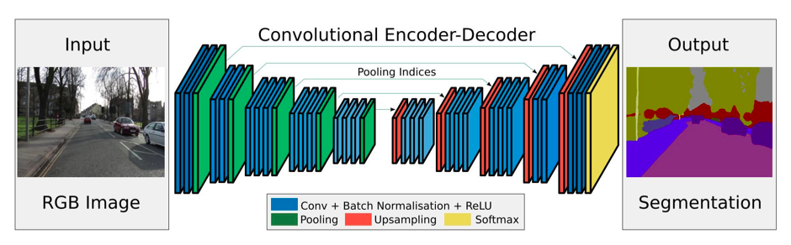
Convolutional Autoencoder
CAE: An encoder-decoder framework but explicitly exploiting spatial relations in images

Slide 45
Deconvolution
Definition
transformations going in the opposite direction of a normal convolution (i.e., up-sampling)
Motivation
Performing pixel predictions such as sementic image segmentation, object detection
Image reconstruction (denoising, impainting)
Generating high-resolution images
How
Traditionally, one could achieve up-sampling by applying interpolation schemes or manually creating rules.
We want to let the network itself learn the proper transformation automatically, without human intervention.
To achieve that, we can use the transposed convolution.

Slide 46
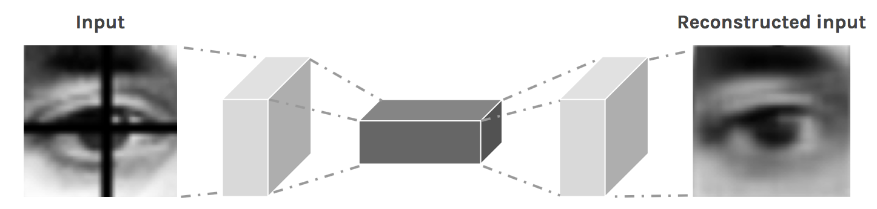
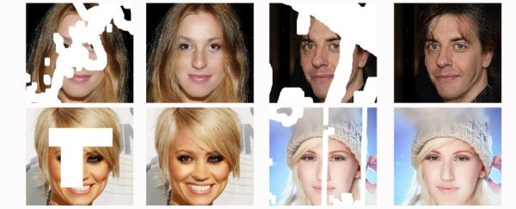
Example Tasks
Inpainting

Slide 47
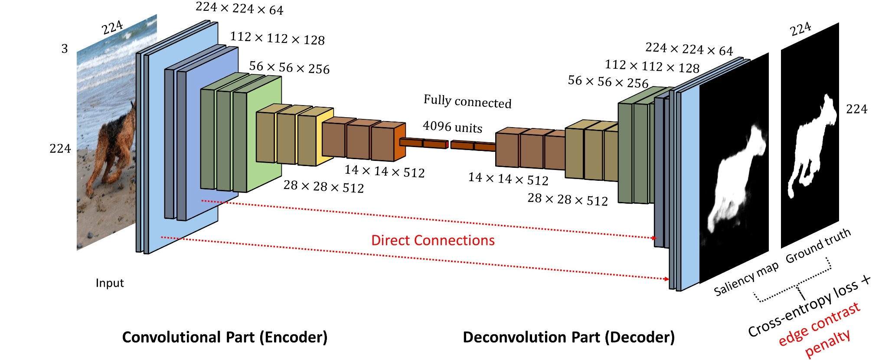
Object detection
https://github.com/arthurmeyer/Saliency_Detection_Convolutional_Autoencoder

Slide 48
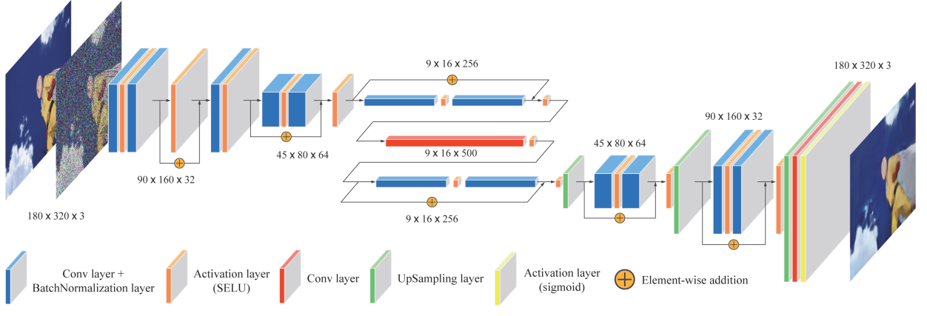
Animation
Animation Video Resequencing with a Convolutional AutoEncoder

Slide 49
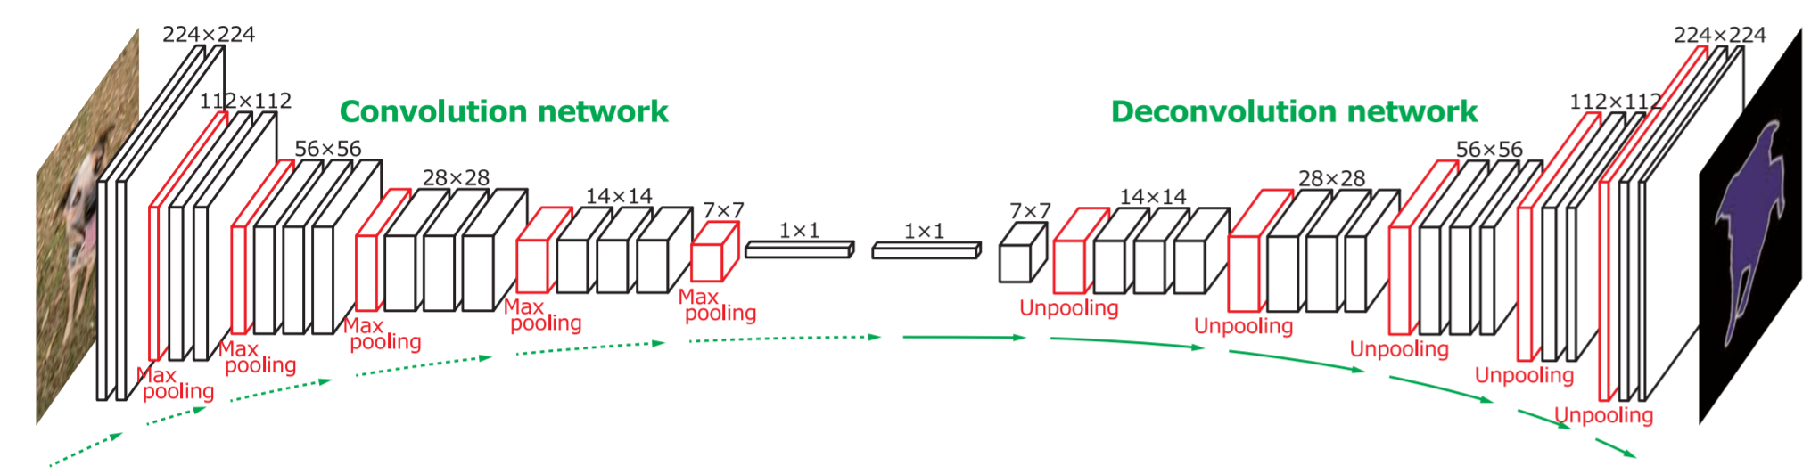
Segmentation
Learning Deconvolution Network for Semantic Segmentation

Slide 50
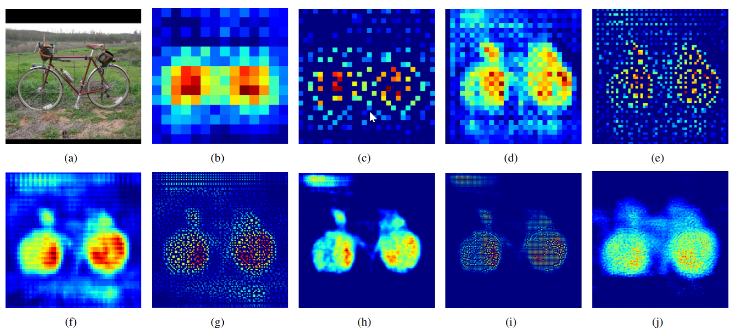
(a) is an input, and the rest are the outputs from (b) the last 14 × 14 deconvolutional layer, (c) the 28 × 28 unpooling layer, (d) the last 28 × 28 deconvolutional layer, (e) the 56 × 56 unpooling layer, (f) the last 56 × 56 deconvolutional layer, (g) the 112 × 112 unpooling layer, (h) the last 112 × 112 deconvolutional layer, (i) the 224 × 224 unpooling layer and (j) the last 224 × 224 deconvolutional layer.

Slide 51

Deconvolution & unpooling

Slide 52









Deconvolution
Suppose no down-sampling is applied. How inverse the convolution step?
Given 4-by-4 image, with 3-by-three kernel. No padding, no stride. The output is 2-by2
x1 x2 x3 x4
w₀₀ w₀₁ w₀₂
w₁₀ w₁₁ w₁₂
w₂₀ w₂₁ w₂₂
y1 y2
y3 y4
x5 x6 x7 x8
$$⨂$$
$$=$$
x₉ x₁₀ x₁₁ x₁₂
$$Y=CX$$
x₁₃ x₁₄ x₁₅ x₁₆
$$Y$$
$$X$$
$$Y$$
$$X=C^{′}Y$$

Slide 53

Unpooling
Record the location of the pooling step and recover.

Slide 54

Checkerboard artifacts
When we look very closely at images generated by neural networks, we often see a strange checkerboard pattern of artifacts.

Slide 55

the deconvolution operation. allow the model to use every point in the small image to “paint” a square in the larger one.
Unfortunately, deconvolution can easily have “uneven overlap,” putting more of the metaphorical paint in some places than others
Conditional generative adversarial nets for convolutional face generation
Two-dimensional deconvolution is even worse
https://distill.pub/2016/deconv-checkerboard/

Slide 56
CNN for time series data
Yoon Kim (2014): Convolutional Neural Networks for Sentence Classification. EMNLP 2014.
https://arxiv.org/pdf/1408.5882.pdf
Code: https://arxiv.org/pdf/1408.5882.pdf [Theano!, etc.]
Goal: Sentence classification:
Mainly positive or negative sentiment of a sentence
Other tasks like:
Question classification: about person, location, number, …

Slide 57

CNN for sentence classify.

Slide 58

CNN for sentence classify.

Slide 59


